Slide 1
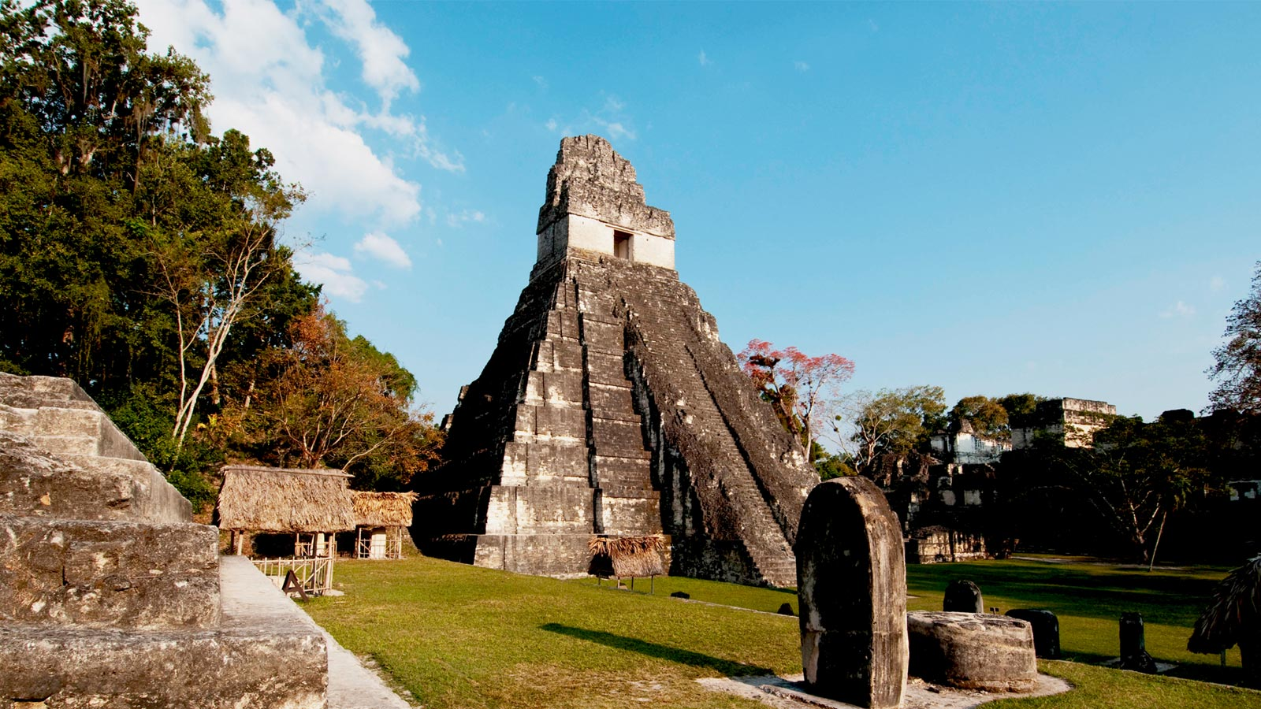
Guatemala 2014

Slide 2
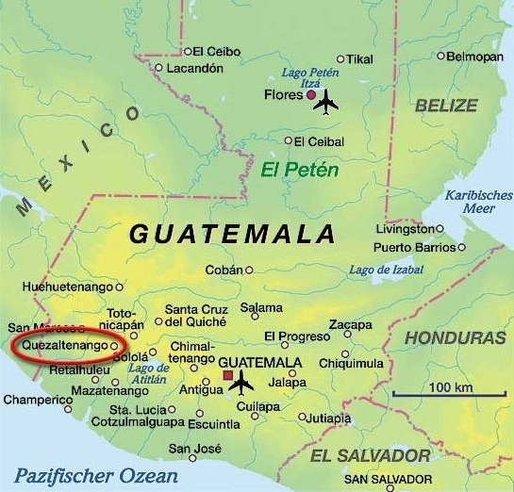
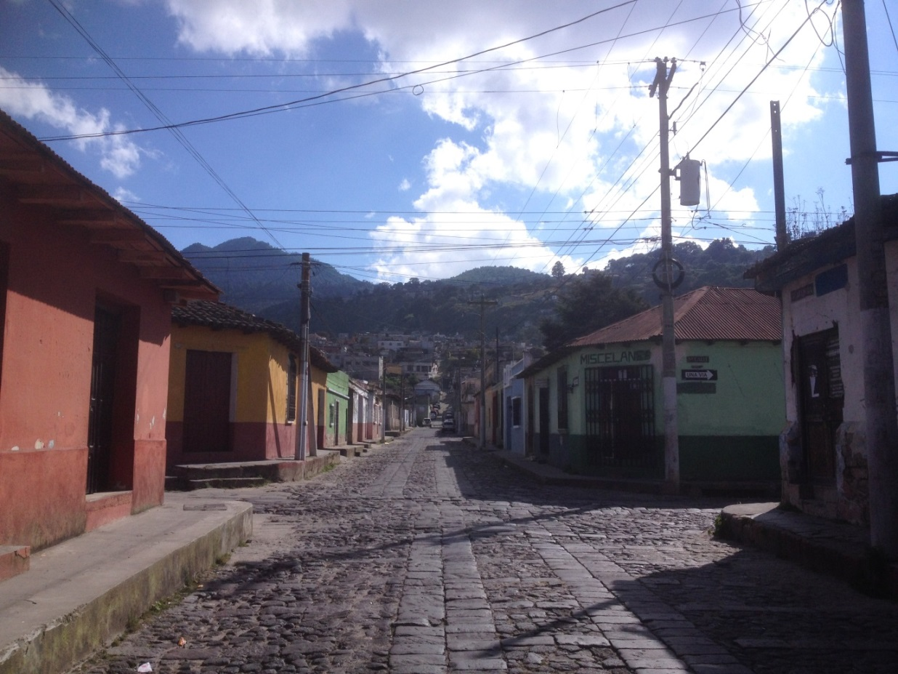
Why AMA and Xela?
Notes:
AMA background and why did I chose this placement
What do they do?
Reasons for placement
Spanish speaking/ Latin America interest, had never been to central america
Fascinating history and culture, interesting country
People affected by civil war
Not paid, but free accomodation (Spare guest room in office with all facilities)
Smaller organisation, see impact

Slide 3
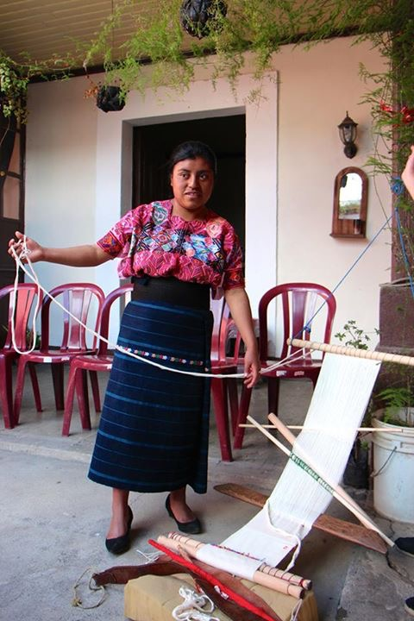
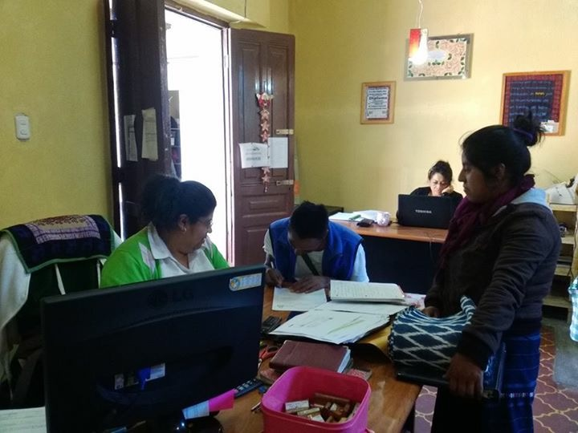
The work – A typical day in the office

Slide 4
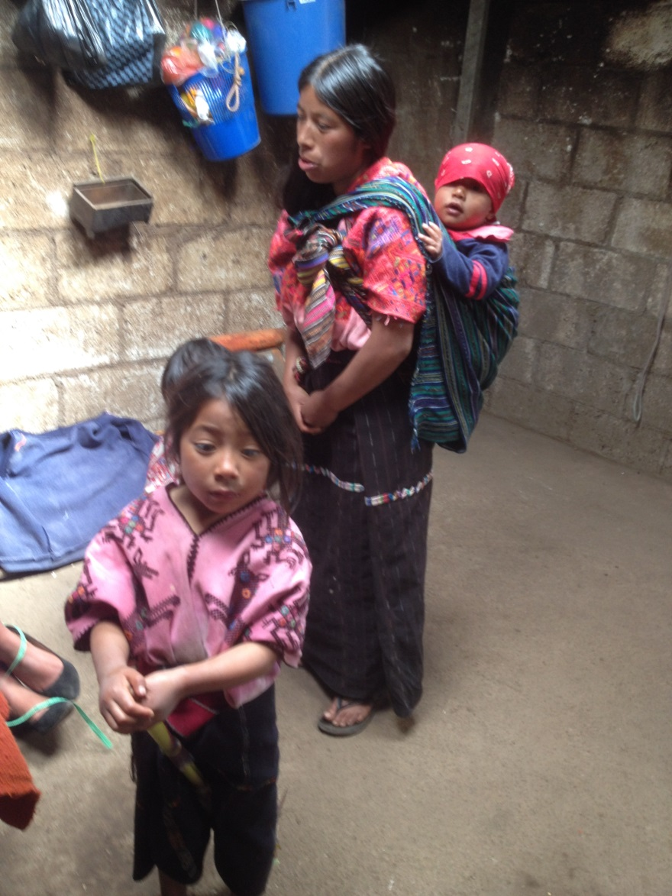
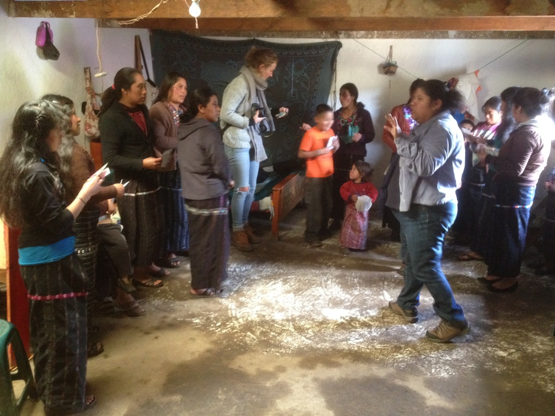
The communities

Slide 5
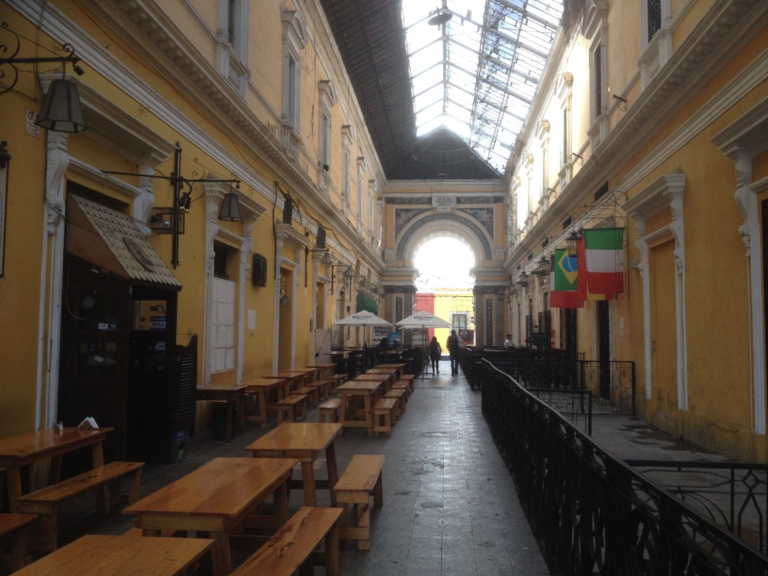
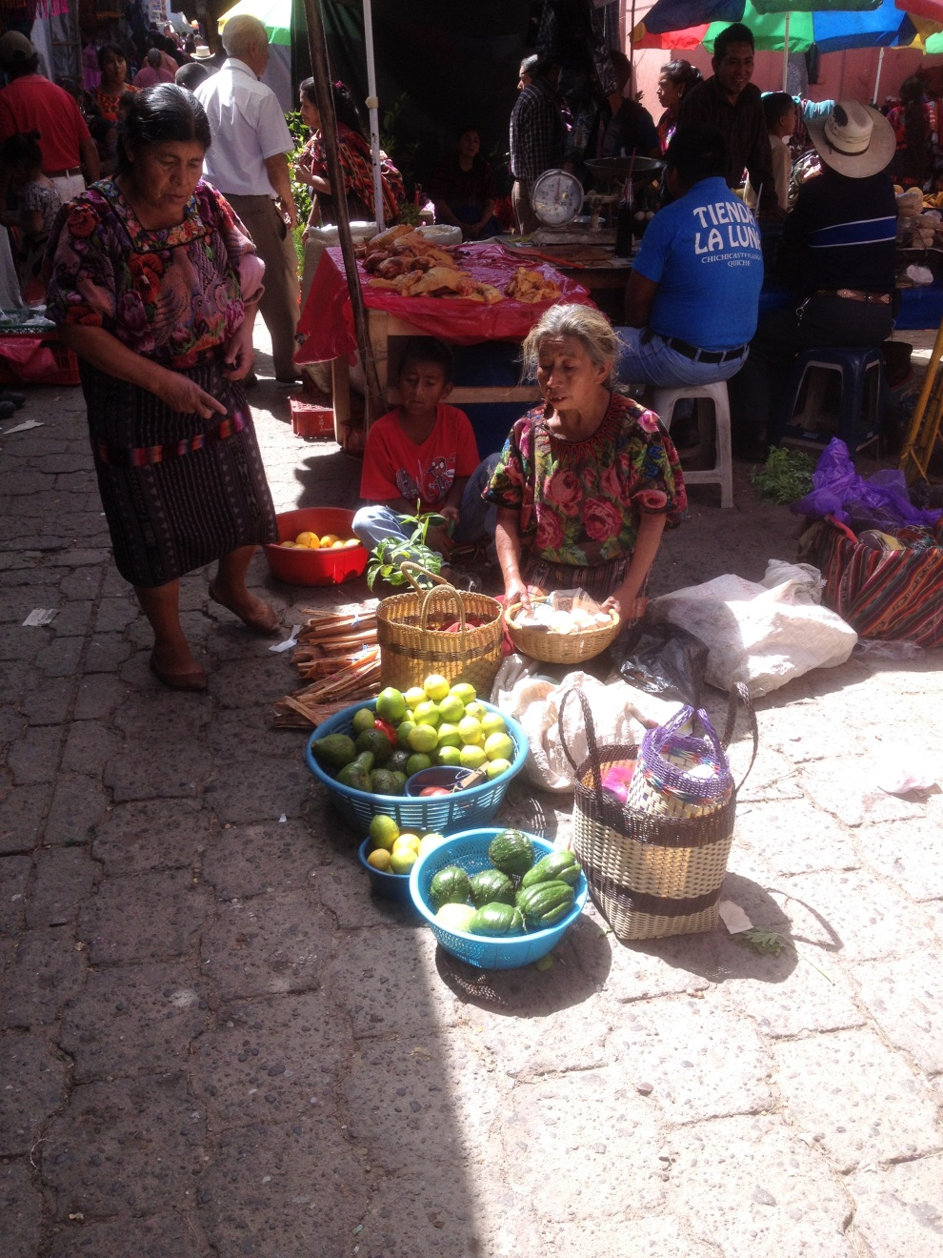
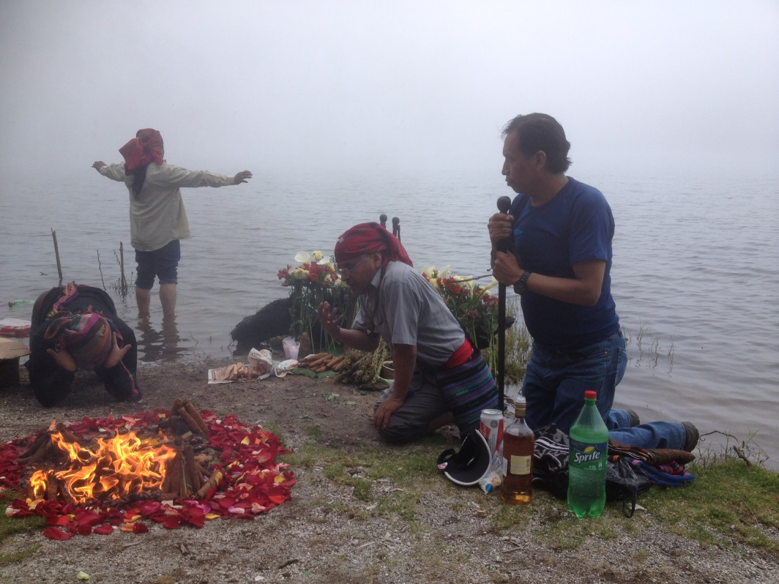
Life in Xela

Slide 6
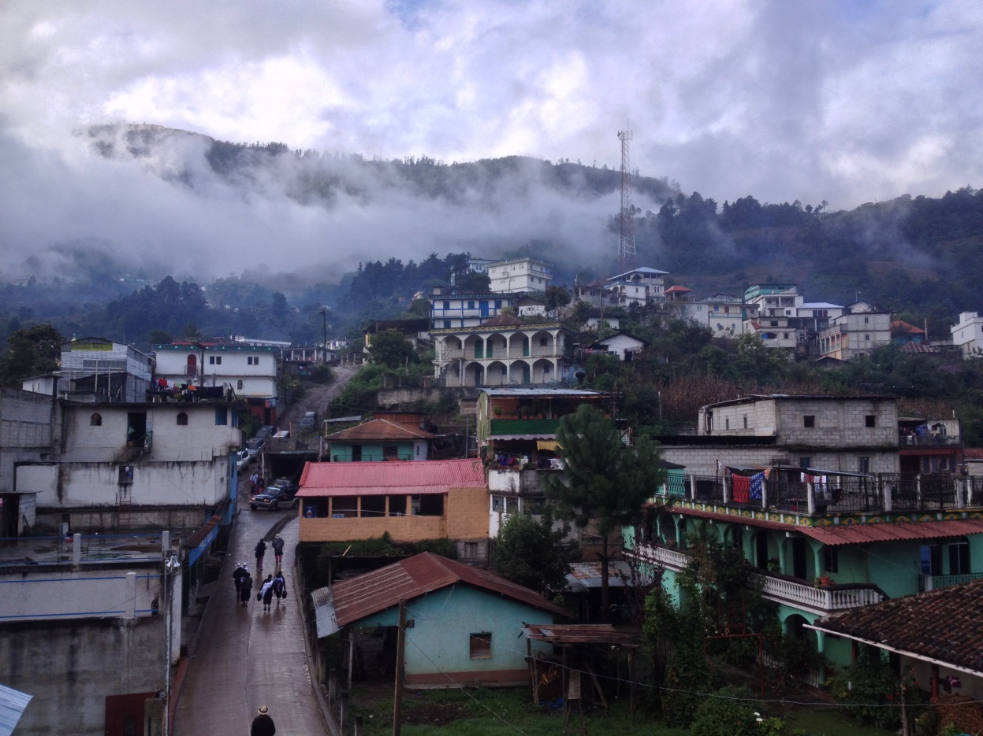
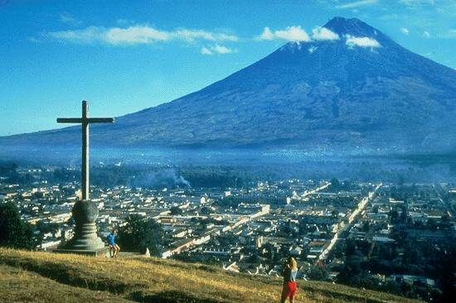
The country

Slide 7
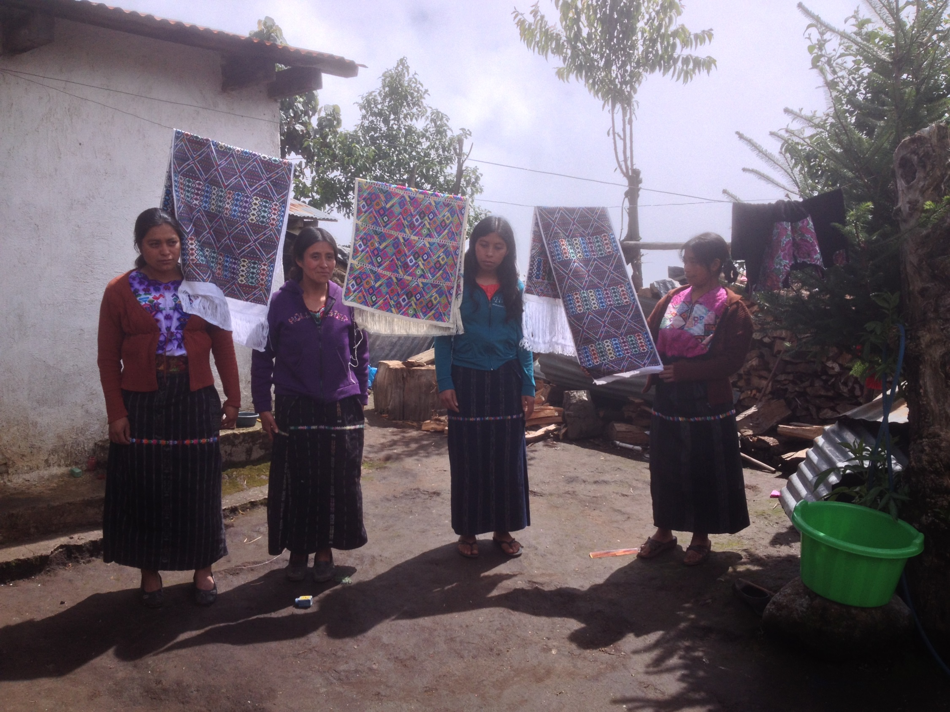
Any Questions? Matthias Kroeger matthias.kroeger@hotmail.com

